Slide 1
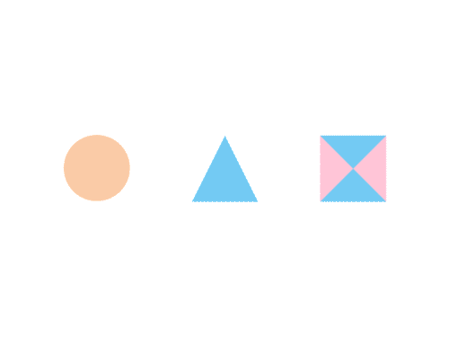

CSE 470/598 Ray Tracing
Ross Maciejewski
rmacieje@asu.edu

Slide 2
Disclaimer
These slides can only be used as study material for the class 470 at ASU
The slides cannot be distributed or used for another purpose

Slide 3
Introduction
OpenGL is based on a pipeline model in which primitives are rendered one at time
No shadows (except by tricks or multiple renderings)
No multiple reflections
Global approaches
Rendering equation
Ray tracing
Radiosity

Slide 4

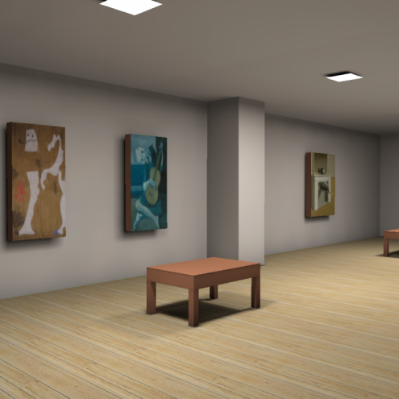
Global Illumination: Introduction
so far: only one interaction between light (from light source) and surface considered → local illumination models
now: model several steps of reflection → global illumination models
two techniques: raytracing & radiosity
Coombe et al., 2004

Slide 5
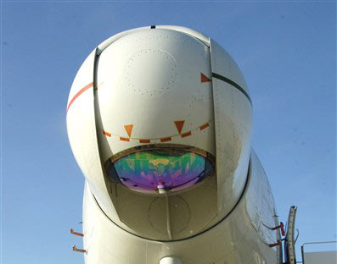
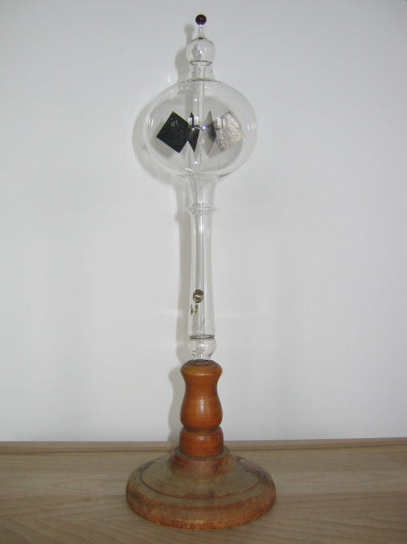
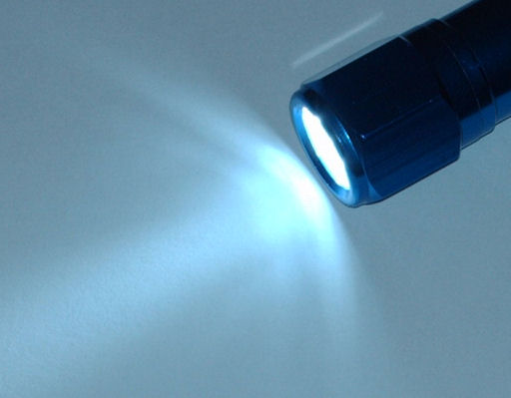
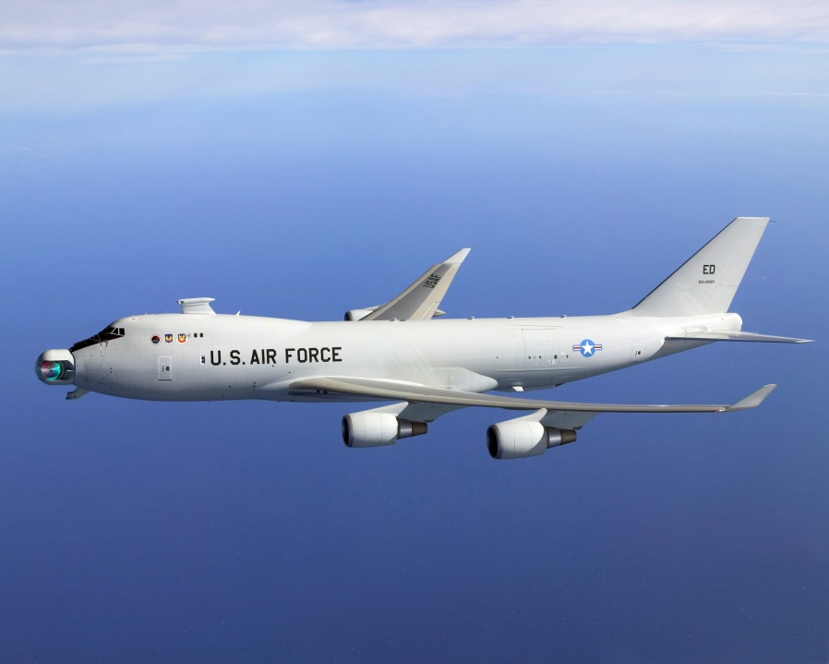
Properties of Light (CG-simplified)
principle/law of conservation of energy
no energy can be created or destroyed
incoming equals outgoing energy everywhere
cg is a special case – visible light as single form of energy:
light energy may convert into other forms
other energy types may convert into light energy

Slide 6
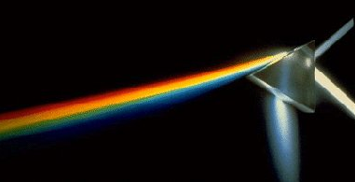
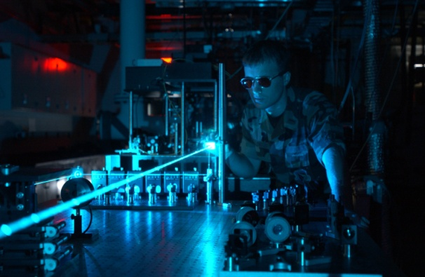

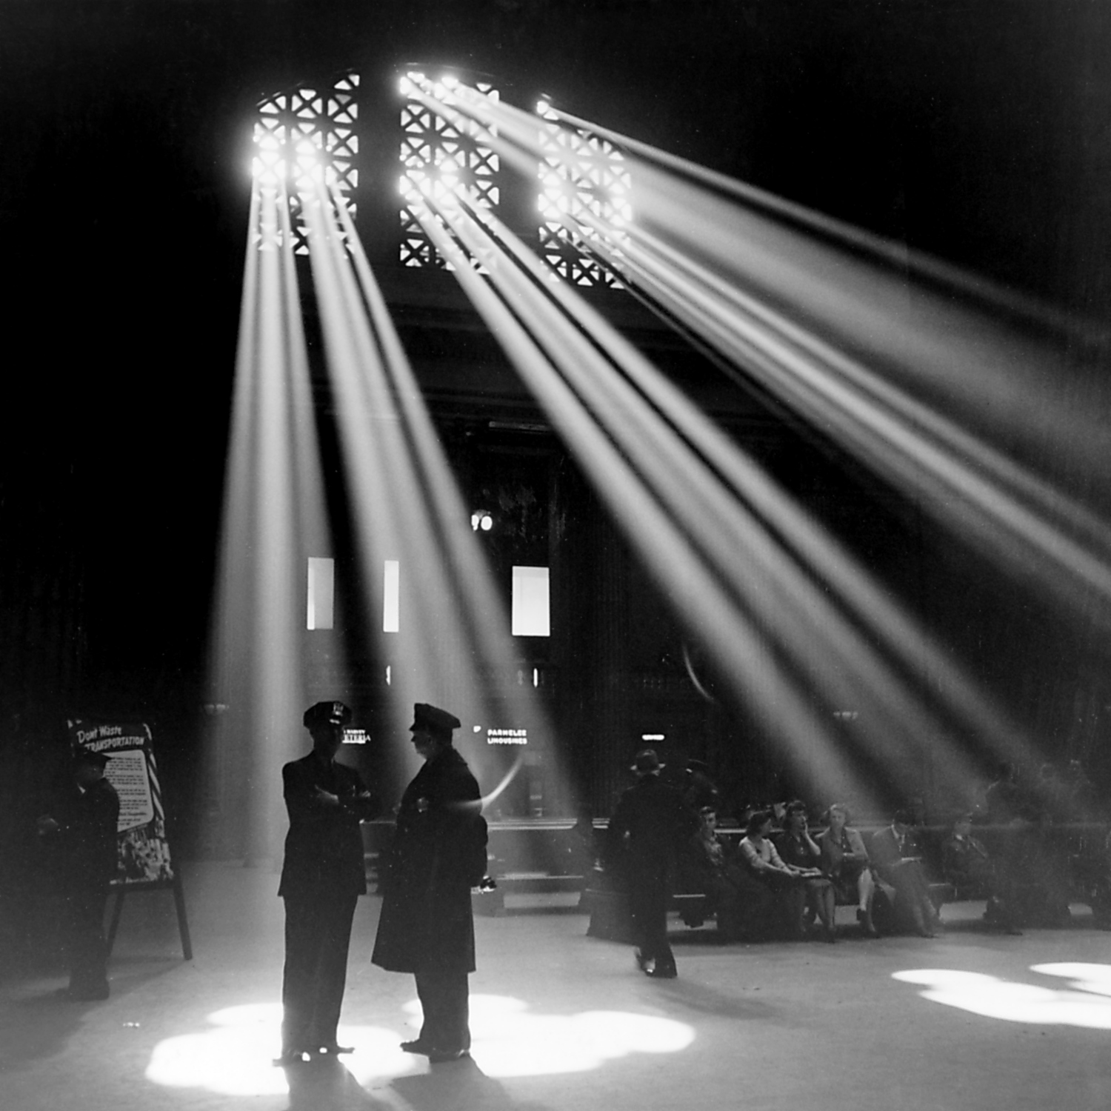
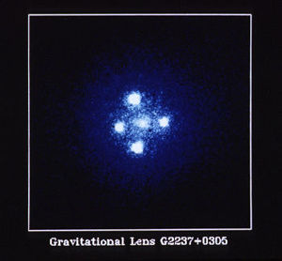
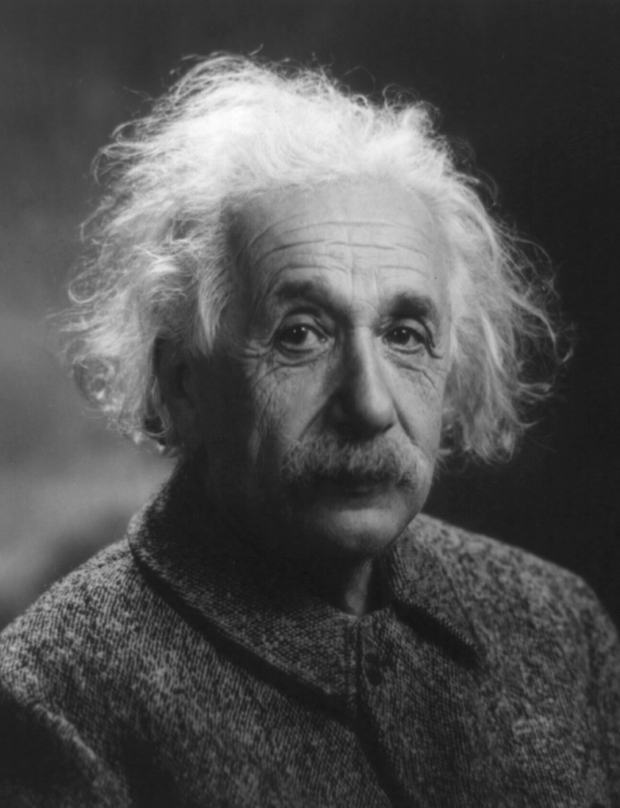
Properties of Light (CG-simplified)
duality of light
light as waves (part of the electromagnetic spectrum) → recall color lecture
light as particles (carrying certain amounts of energy) → use in raytracing & radiosity
cg-light follows straight paths (sorry Einstein!)

Slide 7
Local Illumination Revisited
previously: Phong illumination model (ambient, diffuse, and specular reflection) → only coarse approximation of reality
goal: look at real physical conditions
use particle model of light
derive reflected amount of light depending on
incoming light from different directions
more realistically modeled reflection properties
own emitted light

Slide 8
Recall: Differential Calculus
s
example: walking with changing speeds
distance vs. time, average velocity:
approaching zero-length intervals
∆s
t
∆t
v
t

Slide 9
Looking at Light Propagation
particle count in given volume at x: P(x)
particle density at point x: p(x)
difference approach (approximation):
differential approach:

Slide 10
Looking at Light Propagation
assuming that all the particles we consider move into the same direction
how many particles travel through an area in a given time?
distance traveled: s = v ∙ t
θ
dA

Slide 11
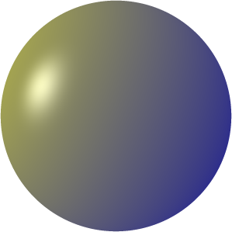
Recall: Angles and Solid Angles
regular angle in 2D (for a circle):
solid angle in 3D (for a sphere):
S
θ
r
ω
S
r

Slide 12
Looking at Light Propagation
energy of a photon (using Planck’s constant h):
energy of many photons:
light coming from one direction:
total light effective at one position
for given λ and given direction

Slide 13
Reflection Behavior: BRDF
dω’
BRDF: bidirectional reflection distribution function
models reflection behavior w.r.t. input and output angles
can be physically measured
also depends on frequency
can model direction-dependent reflection
dω
x

Slide 14
Rendering Equation
: light inward from one direction
: attenuation of inward light due to incident angle (Lambert’s law)
: reflection of light from inward direction to outgoing direction (BRDF)
: light emitted to outward direction
: we look at all solid angles
all together:

Slide 15
Rendering Equation
problems:
is the for other location
equation is extremely difficult to solve for
solving usually through approximations:
finite elements method (radiosity, later)
Monte Carlo integration (raytracing)

Slide 16
Raytracing
solving of the rendering equation through Monte Carlo integration, i.e., through repeated (random) sampling
sampling for each pixel of output image:
further approximations needed: → recursion for specular light rays only
pixel color
emitted light of (first) intersection point
illumination model (e.g., Phong model)
light from light sources plus reflection plus refraction rays

Slide 17

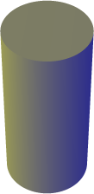
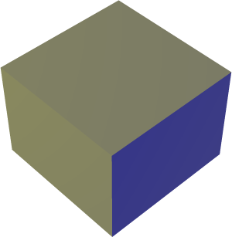
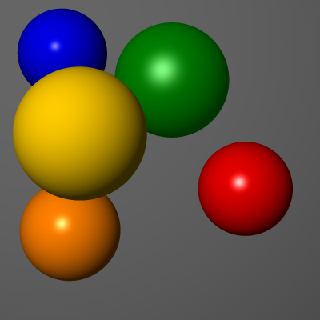
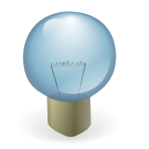
Raycasting
shoot rays; for each intersection compute the local illumination (e.g., using the Phong model)

Slide 18
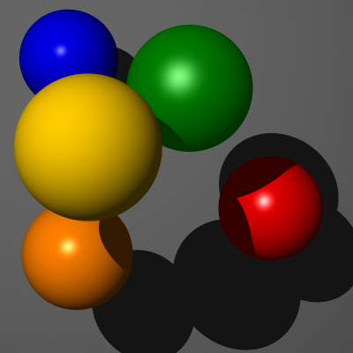
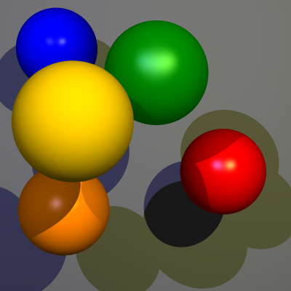
Generating Shadows
shadow rays to test intersections between point and light source

Slide 19
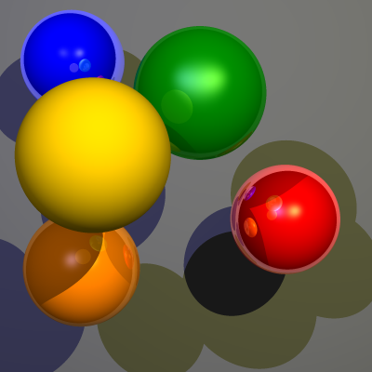
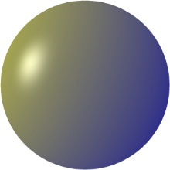
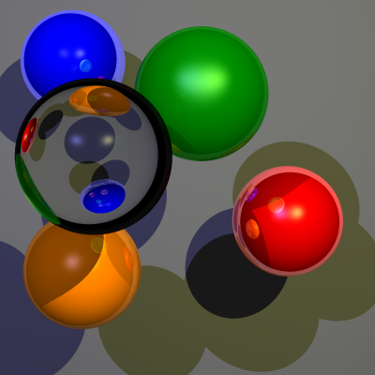
True Raytracing (Recursion)
recursion: also follow reflected rays and refracted rays

Slide 20
Adapted Illumination Model
enhance the Phong model with terms for reflected (I_{r}) and refracted portion (I_{t}) (model by Whitted):

Slide 21
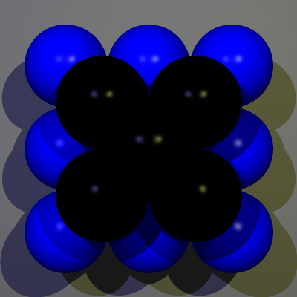
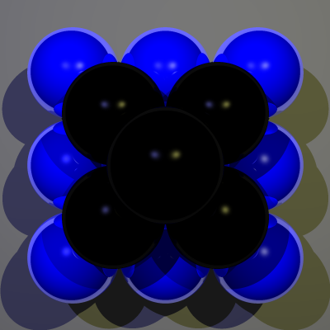
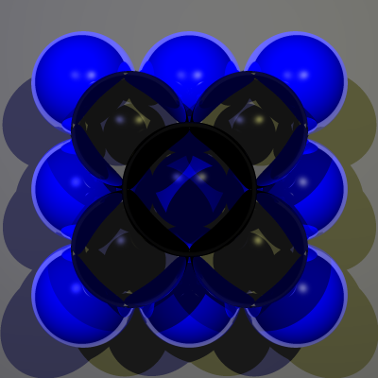
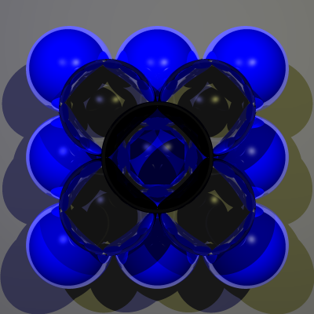
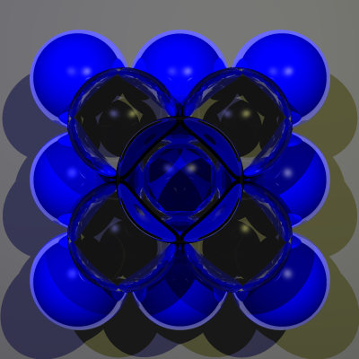



Raytracing Recursion Steps

Slide 22
Properties of Raytracing
models directed global reflections: mirroring effects, shadows (shadow rays)
hidden surface removal included
does not account for certain light effects
caustics (photon tracing)
aerial light sources
(repeated) indirect diffuse reflection
computationally expensive, but highly parallelizable (CPU and GPU)

Slide 23


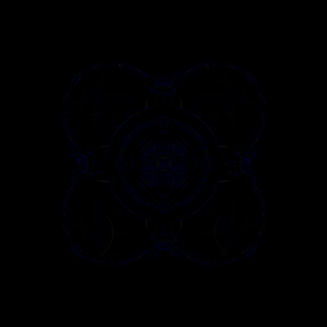
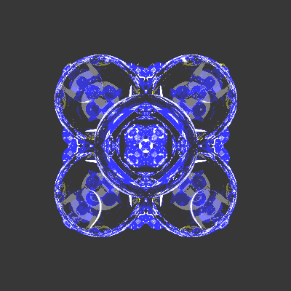
Accelerating Raytracing
typical recursion depth control: stop recursion after max. N steps
adaptive recursion depth control: stop recursion when contribution < k% → can reduce recursion depth to ca. 1–2
N=100
<10%
amplified difference image
difference image

Slide 24
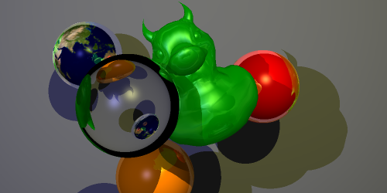
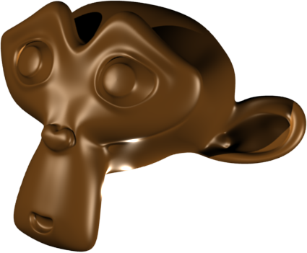
Accelerating Raytracing
bounding volumes to avoid expensive intersection tests for complex objects
bounding spheres or boxes (fast)
hierarchical bounding volumes possible
3,712 triangles 57 m 3 s without bounding sphere 31 m 14s with bounding sphere

Slide 25

Accelerating Raytracing
accelerating the first intersection tests
render ID buffer traditionally; raytrace only secondary rays
potentially mix shading with raytracing: raytrace only surfaces with specular reflection; texture-map reflections onto surfaces

Slide 26
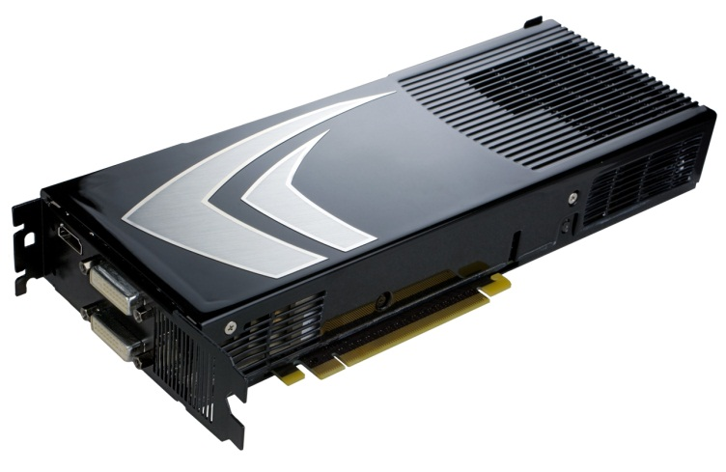
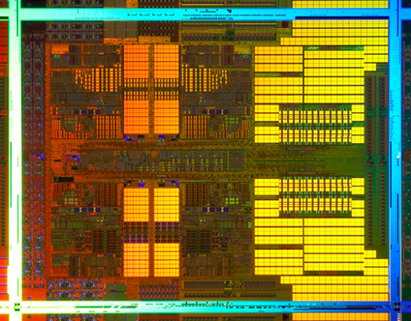
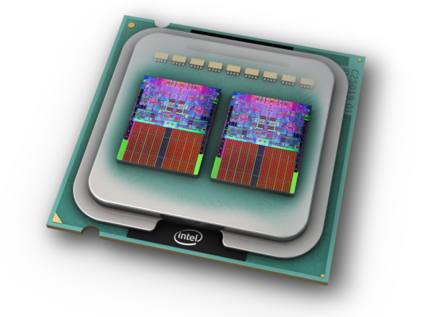
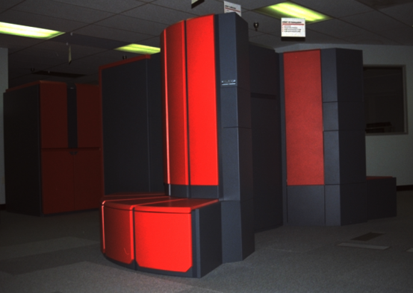
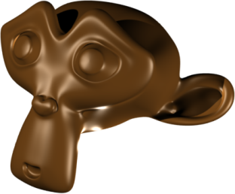
Accelerating Raytracing
highly parallelizable technique
today’s processors are dual-core or quad-cores
GPUs can process even more parallelized (pipelines)
space partitioning
bounding volume hierarchies
binary space partitioning
uniform subdivision grids (octrees)
© Intel
© nVidia
© AMD

Slide 27

Cone Tracing and Beam Tracing
problem: raytracing models ideal reflectors
idea: model imperfect surfaces by bundles of reflected rays in form of cones/pyramids
intersections are sampled/rendered
models imperfect surfaces and soft shadows
intersections hard to derive in general

Slide 28
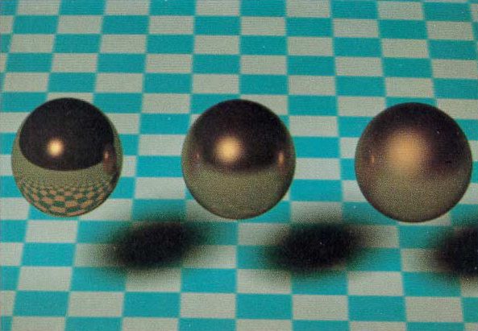
Cone Tracing
John Amanatides, 1984

Slide 29
Distributed Raytracing
similar idea, using groups of rays instead
regular (recursive) raytracing for each of them (can become expensive)
can model imperfect surfaces, soft shadows, motion blur, depth of field
rays generated with respect to importance (angle, time, areal light, lens)

Slide 30
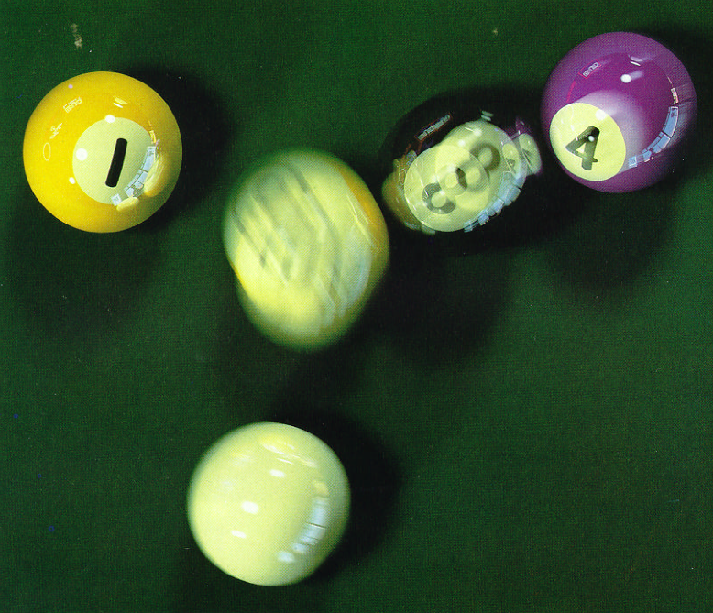
Distributed Ray Tracing
Cook et al., 1984

Slide 31
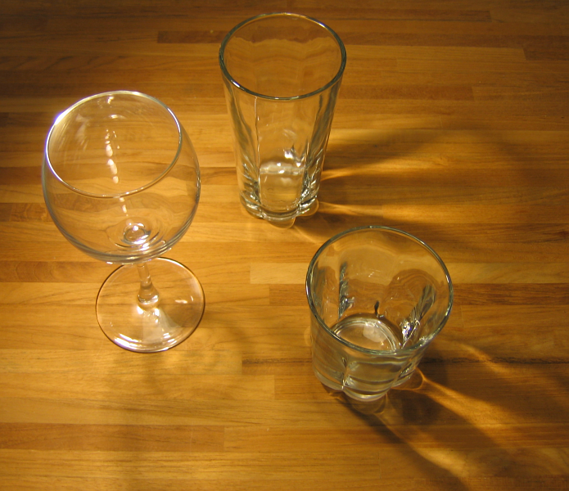
Photon Tracing
some light effects caused by reflection and refraction (“caustics”) not modeled
solution: “reverse raytracing” or photon tracing

Slide 32
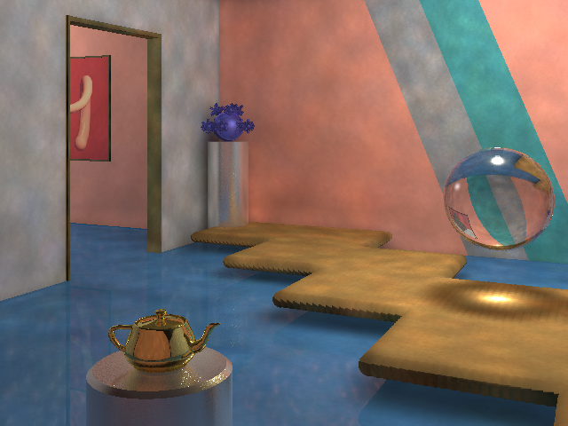
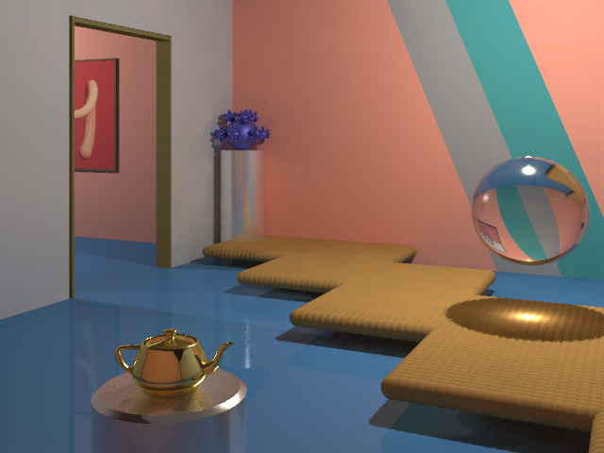
Photon Tracing
basic idea:
trace photons from light source into the scene
reflection, refraction, diffusion, absorption
use photon maps as textures for diffuse reflection in a two-pass technique
Henrik Wann Jensen, 1996

Slide 33
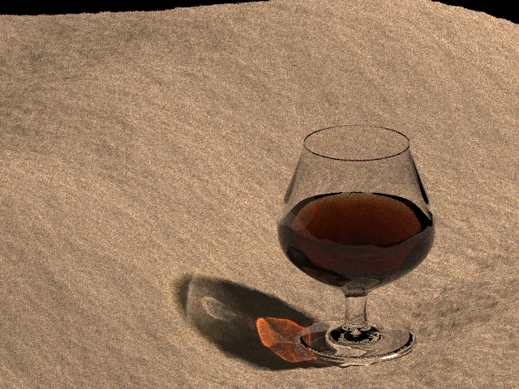
Photon Tracing
Henrik Wann Jensen, 1996

Slide 34
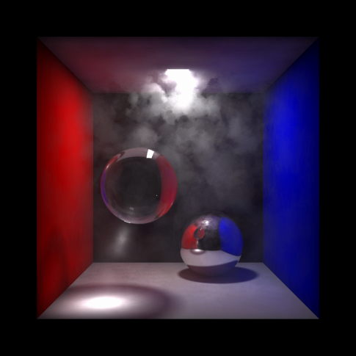
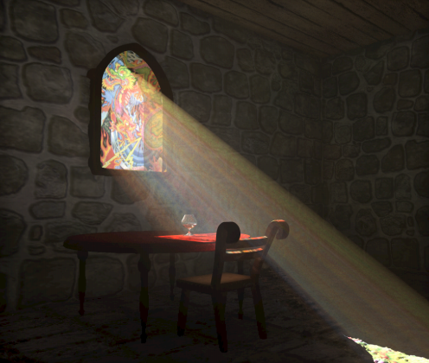
Dispersion
similar to photon mapping
also use photon tracing
check dispersion with dust
store photons in volumes
more expensive
Jensen and Christensen, 1998

Slide 35
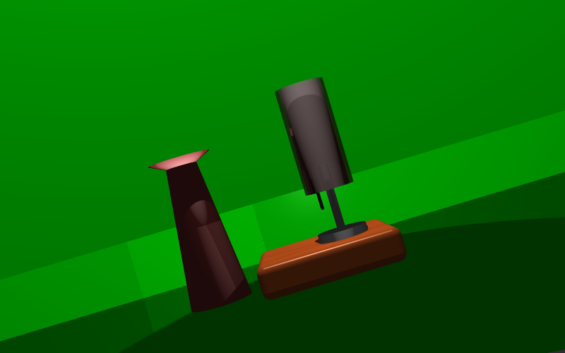

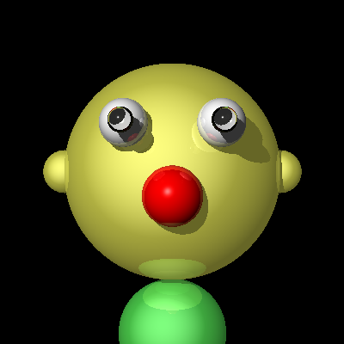
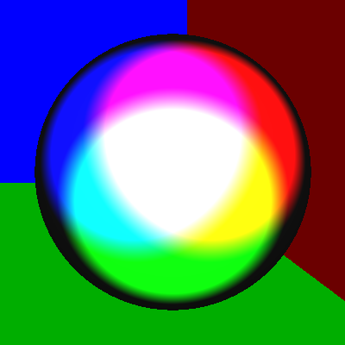
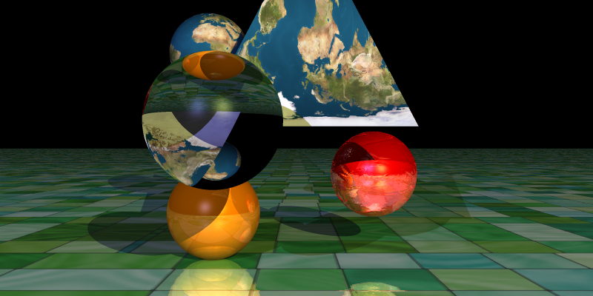
Raytracing: Cool Examples

Slide 36
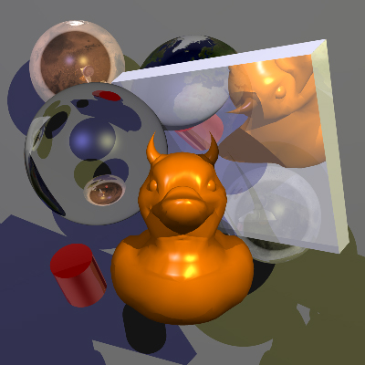
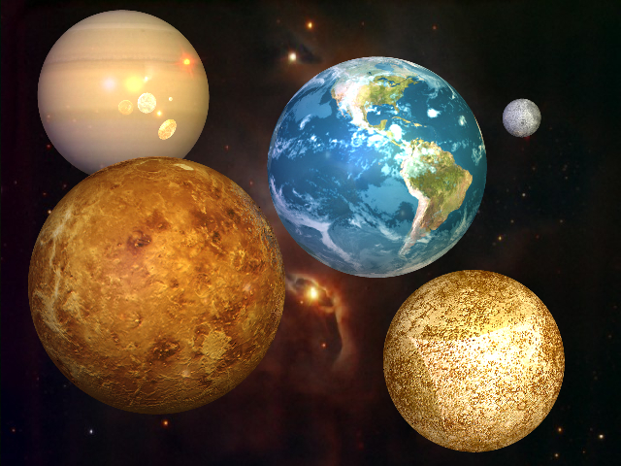
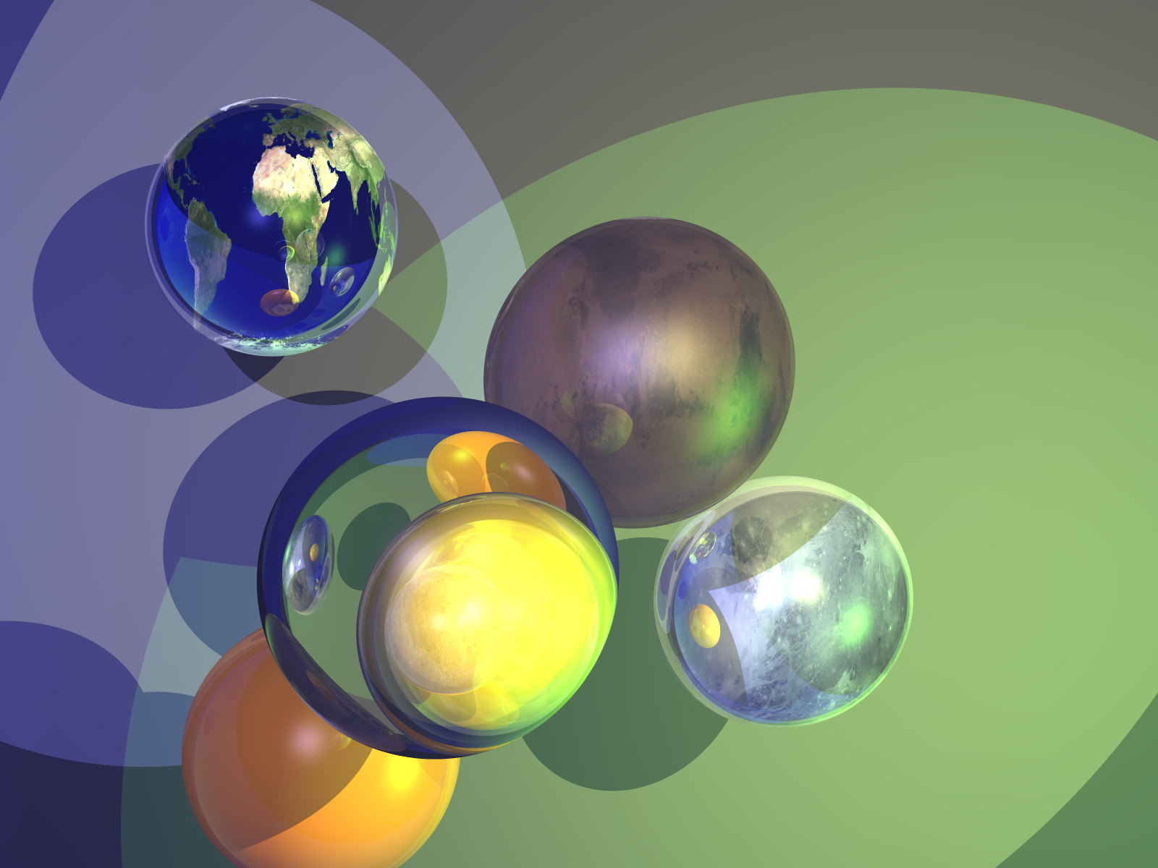



Raytracing: Cool Examples

Slide 37

POV-Ray http://povray.org/
© Gilles Tran, 2006
© René Bui, 2006

Slide 38
Raytracing: Summary
very simple technique to implement: only intersections and normals needed
special case of rendering equation
not restricted to polygons
HSR, shadows, reflections, refraction
restricted to point light sources → effects
repeated diffuse reflection not modeled
fairly expensive to compute, per view point
interactive walk-throughs not possible

Slide 39
Ray Casting
Only rays that reach the eye matter
Reverse direction and cast rays
Need at least one ray per pixel

Slide 40
Ray Casting Quadrics
Ray casting has become the standard way to visualize quadrics which are implicit surfaces in CSG systems
Constructive Solid Geometry
Primitives are solids
Build objects with set operations
Union, intersection, set difference

Slide 41
Ray Casting a Sphere
Ray is parametric
Sphere is quadric
Resulting equation is a scalar quadratic equation which gives entry and exit points of ray (or no solution if ray misses)

Slide 42
Shadow Rays
Even if a point is visible, it will not be lit unless we can see a light source from that point
Cast shadow or feeler rays

Slide 43
Reflection
Must follow shadow rays off reflecting or transmitting surfaces
Process is recursive

Slide 44
Reflection and Transmission

Slide 45
Building a Ray Tracer
Best expressed recursively
Can remove recursion later
Image based approach
For each ray …….
Find intersection with closest surface
Need whole object database available
Complexity of calculation limits object types
Compute lighting at surface
Trace reflected and transmitted rays

Slide 46
When to stop
Some light will be absorbed at each intersection
Track amount left
Ignore rays that go off to infinity
Put large sphere around problem
Count steps

Slide 47
Recursive Ray Tracer
color c = trace(point p, vector d, int step)
{
color local, reflected, transmitted;
point q;
normal n;
if(step > max) return(background_color);

Slide 48
Recursive Ray Tracer
q = intersect(p, d, status);
if(status==light_source) return(light_source_color);
if(status==no_intersection) return(background_color);
n = normal(q);
r = reflect(q, n);
t = transmit(q,n);

Slide 49
Recursive Ray Tracer
local = phong(q, n, r);
reflected = trace(q, r, step+1);
transmitted = trace(q,t, step+1);
return(local+reflected+
transmitted);

Slide 50
Computing Intersections
Implicit Objects
Quadrics
Planes
Polyhedra
Parametric Surfaces

Slide 51
Implicit Surfaces
Ray from p₀ in direction d
p(t) = p₀ +t d
General implicit surface
f(p) = 0
Solve scalar equation
f(p(t)) = 0
General case requires numerical methods

Slide 52
Quadrics
General quadric can be written as
p^{T}Ap + b^{T}p +c = 0
Substitute equation of ray
p(t) = p₀ +t d
to get quadratic equation

Slide 53
Sphere
(p – p_{c}) • (p – p_{c}) – r² = 0
p(t) = p₀ +t d
p₀ • p₀ t²+ 2 p₀ • (d – p₀) t + (d – p₀) • (d – p₀)
– r² = 0

Slide 54
Planes
p • n + c = 0
p(t) = p₀ +t d
t = -(p₀ • n + c)/ d • n

Slide 55
Polyhedra
Generally we want to intersect with closed objects such as polygons and polyhedra rather than planes
Hence we have to worry about inside/outside testing
For convex objects such as polyhedra there are some fast tests

Slide 56
Ray Tracing Polyhedra
If ray enters an object, it must enter a front facing polygon and leave a back facing polygon
Polyhedron is formed by intersection of planes
Ray enters at furthest intersection with front facing planes
Ray leaves at closest intersection with back facing planes
If entry is further away than exit, ray must miss the polyhedron

Slide 57


Ray Tracing Polyhedra

Slide 58

Ray Tracing a Polygon

Slide 59

Ray Tracing a Polygon

Slide 60
Ray Tracing in C++
for each pixel of the screen
{
Final color = 0;
Ray = { starting point, direction };
Repeat {
for each object in the scene
determine closest ray object/intersection;
if intersection exists {
for each light in the scene {
if the light is not in shadow of another object {
add this light contribution to computed color; } } }
Final color = Final color + computed color * previous reflection factor;
reflection factor = reflection factor * surface reflection property;
increment depth;
}
until reflection factor is 0 or maximum depth is reached; }

Slide 61
Ray Tracing in C++
We have to cast a ray, at each one of our pixel to determine its color. This translates as the following C code :
for (int y = 0; y < myScene.sizey; ++y) {
for (int x = 0; x < myScene.sizex; ++x) { // ... }
}
Note the color contribution can be larger than 1.0, so we naively clamp the color to 1.0 at max

Slide 62
Ray Tracing in C++
Where to start the rays?
It's somewhere on our projection screen.
Easy: Make all our rays point in a single direction (towards the positive Z coordinate).
This is orthographic projection!
Types of projections change the way the rays are related to each other, but it does not change the behavior of any single ray!!

Slide 63

Ray Tracing in C++
The ray is defined by its starting point and its direction (normalized) and is then parameterized by a arithmetic distance called "t".
It denotes the distance from any point of the ray to the starting point of the ray.

Slide 64

Ray Tracing in C++
Only move in one direction on the ray from the smaller t to the bigger t.
Iterate through each object, determine if there is an intersection point
Find the corresponding t parameter of this intersection and find the closest one by taking the smallest t that is positive
That means it's in front of our starting point not behind

Slide 65
Ray Tracing in C++
Start by only ray tracing a sphere
A ray is defined by: R(t) = R0 + t * Rd , t > 0 with R0 = [X0, Y0, Z0] and Rd = [Xd, Yd, Zd]
A sphere can be defined by its center and radius with Sc = [xc, yc, zc] So a sphere of radius Sr is:
S = the set of points[xs, ys, zs], where (xs - xc)2 + (ys - yc)2 + (zs - zc)2 = Sr2 To solve algebraically, substitute the ray equation into sphere equation and solve for t.

Slide 66
Ray Tracing in C++
Now we know if the ray intersected a sphere, what now?
Now we compute the color contribution from each light
The lighting in one point is equal to the sum of the contribution of each individual light source.
The problem here is way oversimplified by providing a finite list of well defined point lights.
We rapidly cull any light that is not visible from our side of the surface. That is if the exiting normal to our sphere and the light direction, point towards opposite direction. This is achieved by this simple code :
// sign of dot product tells if they're pointing in the same direction
if ( n * dist <= 0.0f ) continue;
Then we determine if the point is in the shadow of another object for this particular light.

Slide 67
Ray Tracing in C++
The code for this is similar to the intersection code used earlier
Cast a ray from our intersection point towards the light source
It's possible because it is a point light, that is a single point in space.
See if this ray intersects anything, and if so, we stop the iteration because we know that the object is in the light shadow.

Slide 68
Ray Tracing in C++
So, if our point is not in shadow, what do we do?
When we hit such a surface in our raytracer code, we will compute the cosine of the angle theta that the incoming ray does with the surface (via the normal) :
float lambert = (lightRay.dir * n) * coef;
Then we multiply that lambertian coeficient with the diffuse color property of the surface, that will give us the perceived lighting for the current viewing ray.
This gives us the diffuse color component!

Slide 69
Ray Tracing in C++
Now we need to add reflections!
In addition to the diffusion color attribute described above, we'll give our surface a reflection coefficient.
If this coefficient is 0, then that surface is not reflective at all and we can stop our iteration for this pixel and go to the next one.
If this coefficient is greater than 0, then part of the lighting for that surface will be computed by launching a new ray from a new starting point at the incident point on that surface.
The direction of the new ray, is the "reflected" direction, reflection of the incident view ray by the surface normal.

Slide 70
Ray Tracing in C++
float reflect = 2.0f * (viewRay.dir * n);
viewRay.start = newStart;
viewRay.dir = viewRay.dir - reflect * n;

Slide 71
Ray Tracing in C++
Could potentially end up in a situation where each new ray would hit a surface and be reflected and so on forever
In order to avoid infinite loop, we arbitrarily limit the number of iterations by pixel (for example, no more than ten iterations in the current code)
Of course when we hit that limitation the lighting will be wrong, but as long as we have no perfect reflection (less than a hundred percent) each iteration will contribute less than the previous one to the overall lighting
So hopefully cutting after the tenth iteration will not cause too many visual issues.
We could alter that if we are to render a special scene that still requires more (a hall of mirror type of scene for example)

Slide 72
Ray Tracing in C++
Now we want to add in specular highlights
float reflect = 2.0f * (lightRay.dir * n);
vector phongDir = lightRay.dir - reflect * n;
float phongTerm = _MAX(phongDir * viewRay.dir, 0.0f) ; phongTerm = currentMat.specvalue * powf(phongTerm, currentMat.specpower) * coef;
red += phongTerm * current.red;
green += phongTerm * current.green;
blue += phongTerm * current.blue;

